Slide 1
Nuclear Fuel Performance
NE-591-010
Spring 2021

Slide 2
accident scenarios

Slide 3
Kinds of Accidents
Design basis accident: DBA
kind of accident that is anticipated and is explicitly included within the design, to ensure the reactor can cope
Beyond design basis accident: BDBA
accidents that fall outside of what is designed for, because they are deemed too unlikely to be included in design

Slide 4
Reactivity Initiated Accident (RIA)
Reactivity is the departure from criticality: δk = (k − 1)/k
where k is your effective multiplication factor
k = (Neutrons produced in one generation)/(Neutrons produced in the previous generation)
k = ε L_{f} p L_{th} f η – this is your six-factor formula
ε = fast fission factor
L_{f} = fast non-leakage factor
p = resonance escape probability
L_{th} = thermal non-leakage factor
f = thermal fuel utilization factor
η = reproduction factor

Slide 5
Reactivity
Reactivity = rho = ρ = δk = (k − 1)/k
At steady state, k=1, rho=0
Reactivity is affected by the temperature and density of coolant, moderator and fuel
Ideally, nuclear reactors are designed so that a power increase will generate
negative reactivity feedback
and increase in the reactivity (higher k) leads to material changes, which in turn force a negative reactivity (lower k)

Slide 6
Reactivity Initiated Accident (RIA)
Design Basis Accident: Large and rapid insertion of reactivity caused by inadvertent ejection (PWR) or drop (BWR) of a control rod
PWR
Control rod ejection accident (CREA)
Caused by mechanical failure of a control rod mechanism housing, such that the coolant pressure ejects a control rod assembly completely out of the core.
Reactivity increase to the core occurs within about 0.1 s in the worst possible scenario
The most severe CREA would occur at normal coolant temperature and pressure, but with nearly zero reactor power

Slide 7
Reactivity Initiated Accident (RIA)
BWR
Control rod drop accident (CRDA).
Initiated by the separation of a control rod blade from its drive mechanism.
Detached blade remains stuck in position until it suddenly becomes loose and drops out of the core in a free fall.
Most severe CRDA would occur at with the coolant close to room temperature and atmospheric pressure, and the reactor at nearly zero power

Slide 8
RIA
RIA leads to a fast rise in fuel power and temperature
This power ramp can lead to failure of fuel rods and release of radioactive material (or potentially fuel) into coolant
Release of hot fuel into water can cause rapid steam generation and pressure pulses, damaging other core internals
To prevent such consequences, safety criteria are set up to limit energy injection into the fuel

Slide 9
Sequence of RIA

Slide 10
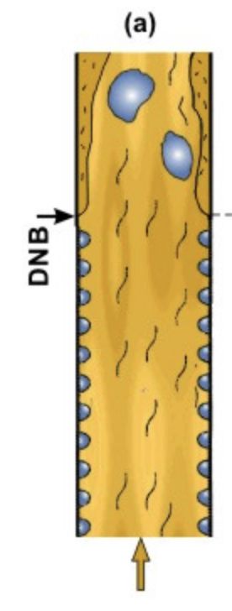
Departure from Nucleate Boiling
If the heat flux of a boiling system is higher than the critical heat flux (CHF) of the system, the bulk fluid may boil, or in some cases, regions of the bulk fluid may boil where the fluid travels in small channels
Large bubbles form, sometimes blocking the passage of the fluid
This results in a departure from nucleate boiling (DNB) in which steam bubbles no longer break away from the solid surface of the channel, bubbles dominate the channel or surface, and the heat flux dramatically decreases
Vapor essentially insulates the bulk liquid from the hot surface, increasing surface temperatures

Slide 18
Loss of Coolant Accident (LOCA)

